Slide 1
Microsoft Student Partner
Nitin Kumar

Slide 2
Tech Session
Window Phone 7 (Silverlight, XNA) 1st Hour
Cloud Computing (Window Azure) 2nd Hour
Web Tech (Web Matrix) 3rd Hour

Slide 3
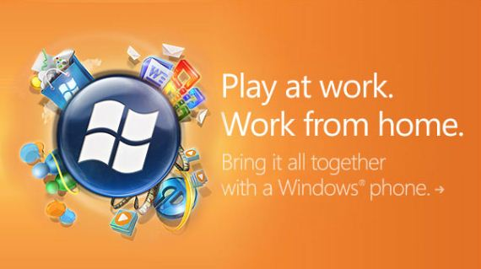
Window Phone 7 Video

Slide 4
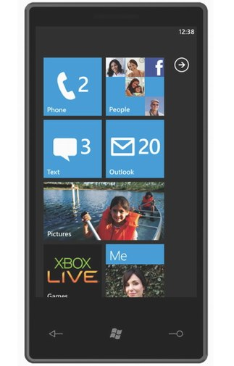
Window Phone 7

Slide 5
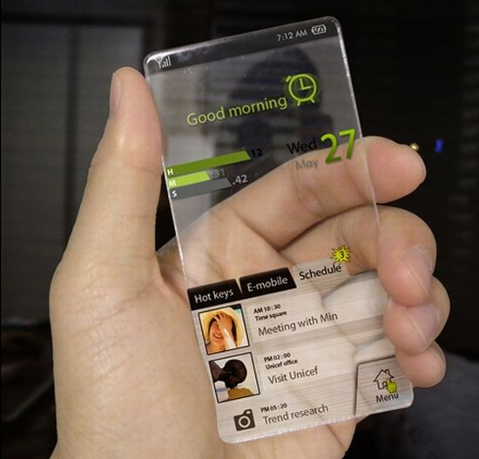
Plans

Slide 6
Overview of Window Phone 7
Complete overhaul from the previous OS versions
Slick, Touch-friendly User Interface
Social and Productivity Hubs
Office Hub with OneNote, Documents and SharePoint integration for collaboration
Outlook Mail application which gives similar features as on the desktop
Zune Player, Xbox Live & Bing Maps
3 hardware buttons- Home, Search and Back
Application development based on Silverlight & XNA
Primary development tools: Visual Studio 2010, XNA Game Studio 4.0 & Expression Blend 4 for Windows Phone.

Slide 7
Hardware Capabilities
Capacitive, 4-point multi-touch screen with WVGA (800x480) resolution
1 GHz ARM v7 "Cortex/Scorpion" or better processor
DirectX9 rendering-capable GPU
256MB of RAM with at least 8GB of Flash memory
Accelerometer with compass, ambient light sensor, proximity sensor and Assisted GPS
5-megapixel camera with an LED flash
FM radio tuner
6 dedicated hardware buttons - back, Start, search, camera, power/sleep and Volume Up and Down

Slide 8
Video for Window Phone 7

Slide 9
Platforms for Window Phone 7 App development
Silverlight
XNA

Slide 10
Microsoft Silverlight
Microsoft Silverlight is an application framework for writing and running rich Internet applications with emphasis on multimedia, animations, and graphics, with features and purposes similar to those of Adobe Flash. The run-time environment for Silverlight is available as a plug-in for most web browsers. While early versions of Silverlight focused on streaming media, current versions support multimedia, graphics and animation, and give developers support for CLI languages and development tools.

Slide 11
Silverlight for Windows Phone
Silverlight is the application development platform for Windows Phone 7. High performance gaming is also supported through the XNA Framework.
Silverlight for Windows Phone supports core Silverlight capabilities in managed .NET code with XAML including:
High quality video and audio using a wide range of codecs, DRM and IIS Smooth Streaming
Deep Zoom for enhanced reading and photo browsing experiences
Vector and Bitmap Graphics and animation

Slide 12
Silverlight for Windows Phone
Silverlight can also access the unique capabilities of the phone including:
Hardware acceleration for video and graphics
Accelerometer for motion sensing
Multi-touch
Camera and microphone
Location awareness
Push notifications
Native phone functionality

Slide 13
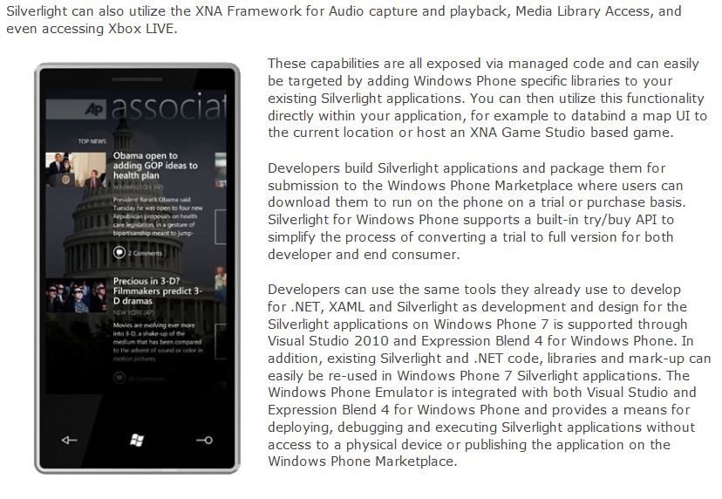
Silverlight for Windows Phone

Slide 14
Preview of the Window Phone 7 Developer Tools
Let me show you the preview of the software which we use in developing apps for Window Phone 7
Visual Studio 2010
Window Phone Emulator
Silverlight
XNA Game Studio 4
Microsoft Expression Blend
.Net Framework

Slide 15
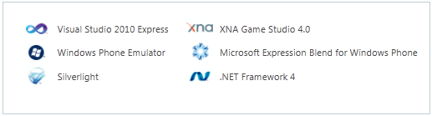
Windows Phone 7 Developer Tool

Slide 16

Microsoft XNA
Microsoft XNA is a set of tools with a managed runtime environment provided by Microsoft that facilitates computer game development and management. XNA attempts to free game developers from writing "repetitive boilerplate code” and to bring different aspects of game production into a single system.

Slide 17
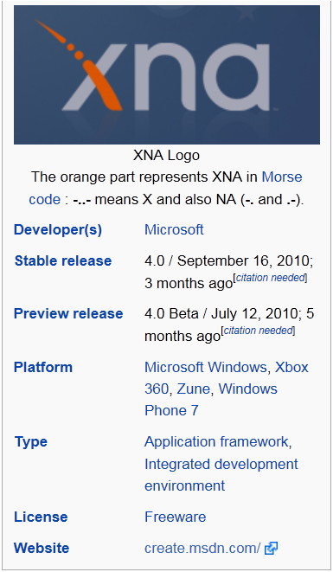
Microsoft XNA

Slide 18
Microsoft XNA
XNA currently encompasses Microsoft's entire Game Development Sections, including the standard Xbox Development Kit and XNA Game Studio.
XNA originally came out of Xbox New Architecture development. Instead of being released under the Xbox name, the Xbox 360 was released, and XNA became defined as "XNA is Not an Acronym" (being recursive and paradoxical in definition, similar to its logo).

Slide 19
XNA for Window Phone 7
Another example of where you might want to access XNA APIs from a WP7 Silverlight application; touch gesture support.
Although Silverlight offers manipulation support, it has no direct support for the higher level concept of “gestures” (eg tap, flick).
To access the XNA gesture support you’ll need to add a reference to the Microsoft.Xna.Framework.Input.Touch XNA assembly. I’ve also added a reference to Microsoft.Xna.Framework as that contains the definition for the Vector2 struct that I use to give some feedback of the gesture position / scope for the purposes of the demo. You may not need it in your app.

Slide 20
Initiating Touch Feature
In the Microsoft.Xna.Framework.Input.Touch namespace is a class called TouchPanel that is the entry point for gesture support in XNA. It allows us to enable gestures.
An XNA application operates in a “game loop”. In other words, rather than being event-driven (the user has clicked on a button), it’s time based and polls for input at specific intervals (typically 30 times / second on a WP7 device). As a result there is no way for the TouchPanel to notify us that a gesture has occurred. We can’t subscribe to a GestureReady event or anything of that nature.

Slide 21

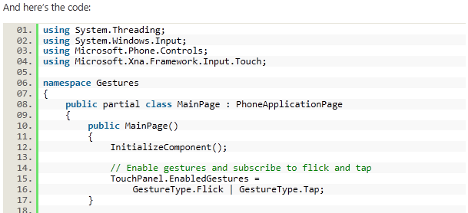

Slide 22
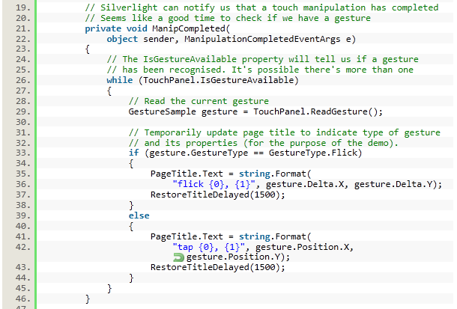

Slide 23
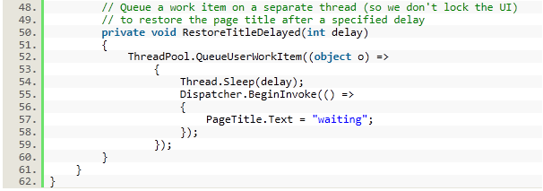
Code for Initiating the touch and flick feature.
Let me show you the video that how it works.

Slide 24
Video for XNA gaming platform.

Slide 25
Thank You.

